Slide 1
Secure smart healthcare data with data Aggregation
Team Details
KANCHUKOTA SHRUTHI(20EG105419)
PASUPULA SOWMYA(20EG105441)
CH. YUVA SHRUTHIK(20EG105734)
Project Supervisor
Mr. Jayendra Kumar
Assistant Professor

Slide 2
Introduction
The evolution of digital technology has brought in a new way of doing things in the healthcare sector, commonly referred to as smart healthcare. This contemporary approach to health management integrates various forms of health data, including patient records, vital statistics, and real-time health monitoring, to enhance the efficacy and personalization of medical care. The promise of smart healthcare systems lies in their ability to process vast quantities of data.
However, the collection and processing of health data present two major challenges for smart healthcare systems. First, the constant influx of data into the centralized healthcare server overwhelms the server with computation and traffic. Second, the data collection may lead to the disclosure of users’ sensitive information.

Slide 3
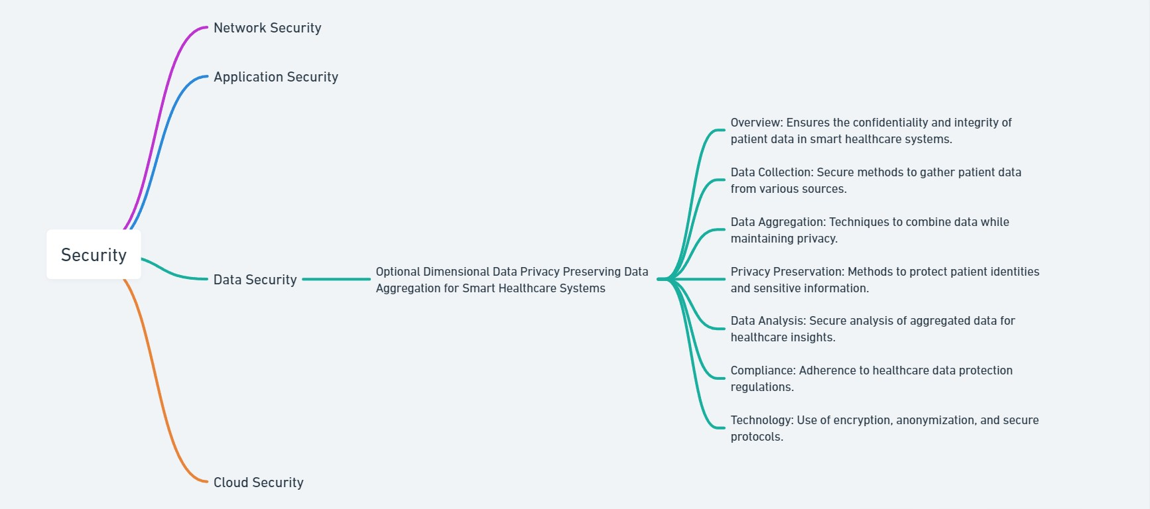
Concept Tree

Slide 4
Literature
Sl.No | Author | Strategies | Advantages | Disadvantages
1. | Alex Adim Obinikpo and Burak Kantarci | The use of various deep learning models like Convolutional Neural Networks (CNNs),Recurrent Neural Networks (RNNs), and their variants for analysing big sensed data. | -Ability to process large volumes of data efficiently. -Enhanced accuracy in disease diagnosis and prediction. | -High computational requirements and associated costs. -Need for large, diverse datasets to train models effectively.
2. | QIONG CAI, HAO WANG, ZHENMIN LI ,AND XIAO LIU | The integration and analysis of multimodal data using data-driven approaches. | -Enhanced diagnostic accuracy through comprehensive data analysis. | -Complexity in integrating and processing diverse data types.
3. | R. Saha et al. | Novel IoT framework for monitoring oxygen saturation in COVID- 19 patients. | -Real-time monitoring and early detection of severe COVID-19 Symptoms. -Improved patient management and healthcare response. | -Enhanced data security and patient privacy through blockchain integration. -Potential challenges in the deployment and maintenance of IoT devices. .
4. | N.Mohamm adzadeh | This underscores wearable sensors' pivotal role in monitoring vital signs and disease progression,especially in epidemic control. | - Wearable Sensor Significance - Need for Extensive Research - Ethical Compliance -Technological Advancements | -Data security risks, interoperability issues, potential patient resistance, and variability in sensor accuracy, posing challenges to effective implementation .

Slide 5
Literature(cont..) selected strategy:
Author(s) | Method | Advantages | Disadvantages
Y. Liu, W. Guo, C. I. Fan | A practical privacy preserving data aggregation (3PDA) scheme for smart grid | The computation cost and communication overhead are reduced in order to promote the practicability | single user's privacy is not protected
H. Shen, M. Zhang, and J. Shen | “Fault-tolerant privacy preserving data aggregation for smart grid, | solution still works functionally even if up to n−k SMs fail; | Aggregation accuracy is less
Y. Liu, W. Guo, C. I. Fan | Efficient privacy-preserving cube-data aggregation scheme for smart grids | we propose a batch verification scheme in multi-dimensional data to reduce authentication cost. | data concerning user's consumption might reveal sensitive information

Slide 6
Problem Statement
In smart healthcare systems, the extensive collection of multidimensional health data raises severe privacy concerns. The challenge lies in safeguarding the privacy of sensitive health information while maintaining the utility of the data for healthcare purposes. The collection and processing of health data present two major challenges for smart healthcare systems. First, the constant influx of data into the centralized healthcare server overwhelms the server with computation and traffic. Second, the data collection may lead to the disclosure of users’ sensitive information.

Slide 7
Problem Illustration
Existing method uses Paillier cryptosystem which is time taking and for data aggregation data in added in to single message which is not easy to decrypt and show data as different parameters
data | Key | Total message and keys
Patient parameter 1 | key 1
Patient parameter 2 | key 2
Patient parameter 3 | key 3
Aggregate all parameters p1+p2+p3 =P4 | For three keys K1+k2+k3 = k4 | Final data: P4 Final Key: k4

Slide 8
Proposed Method
To overcome the challenge of data aggregation and data security, we introduce the fog-based frame into healthcare systems along with time access control.
In a fog-based frame, fog nodes are widely distributed near data terminals, collect data directly from terminals, and preprocess the data before reporting to the server, thereby greatly reducing the burden on the server.
As for the second challenge, the difficulty lies in how to guarantee both data availability and privacy in data collection.
In this project, when we discuss data availability and privacy, encrypting patients’ data separately and aggregating keys in a single request and respond to user to get all keys in single request and encrypt data using AES algorithm and provide time based access to restrict user download based on patient interest.

Slide 9
Proposed Method Illustration
1.let an patient be 'p' after registering and login into the web page the paitent should fill the file f in a particular time 'T'.
2.file f contains parameters such as
-heart rate 'hr'
-blood pressure 'bp'
-body temperature 'bt'
-body weight 'bw'
3.Then this file is upload to server
before uploading the file, the file is encrypted using a secret key 'sk'
that is each parameter is encrypted with its separate keys generated like
-heart rate 'hr' is encrypted using a key 'hrk' which generates an cipher text 'hrct'
-blood pressure 'bp' is encrypted using a key 'bpk' which generates an cipher text 'bpct'
-body temperature 'bt' is encrypted using a key 'btk' which generates an cipher text 'btct'
-body weight 'bw' is encrypted using a key 'bwk' which generates an cipher text 'bwct'

Slide 10
Proposed Method Illustration
4.This encrypted file generate an cipher text file 'ctf'
5.this file 'ctf' is send to fog server
6.on User request for accessing the file the fog server will aggregate the keys and generate a single key
-that is aggregated key 'agk' that is agk=hrk+bpk+btk+bwk
7.time taken for
-fog server-t1(all parameters are send to user at one time t1)
-service server-t1,t2,t3(each parameter has each time of sending each key)
8.output
download time of key send to user on request is
fog server-single key all data is send to user at once that is agk
cloud-final calculated time is t1,t2,t3=final count

Slide 11
Parameter
Time attribute access control:
A real-time attribute is an attribute whose values depend on time ti∈T. In our model, availability of a resource oat time ti in environment for a subject s is determined based on the real-time attributes attr (x, ti),x∈ {s, o, e},with values in a linearly ordered set of availability labels
L={`m=hi º`m−1º. . . º`1=lo}.2
The availability label of attr(x, ti)is called priority when x is a subject, congestion when x is an object, and criticality when x is the environment. Availability labels are dynamically determined based on user events, the context of the requested service and system events

Slide 12
Parameter
Time taken to send the keys:
The key generation algorithm will take as input a set of attributes S and output a key that identifies with that set. The algorithm first chooses a random r ∈ Zp, and then random rj ∈ Zp for each attribute j ∈ S. Then it computes the key as
SK = D = g (α+r)/β , ∀j ∈ S : Dj = g r · H(j) rj ,D′ j = g rj
download time of key send to user on request is
-fog server-t1(all parameters are send to user at one time t1)
-service server-t1,t2,t3(each parameter has each time of sending each key sk)

Slide 13
Experiment Environment
Software Requirements:
Coding Language - Java
Front End - Html, css
IDE - NetBeans
Back End - MySQL

Slide 14
Project status
S.No | Functionality | Status (Completed /in-progress/Not started)
1 | Patient-register, Login Fog server-login service server-login User/Doctor-login pages | Completed
2 | Patient-upload patient details and encrypt with AES algorithm -view encrypted data | Completed
3 | Patient-Give time access control to download data -send the encrypted data to fog server | In-progress
3 | Fog server- view encrypted patient data -send to service server -view request to send all keys to receiver ( all at a time ) -calculate time for sending all keys at a time | In-progress
4 | service server-view encrypted data -view request and send keys to patient ( one by one ) -calculate time to send all keys | Not started

Slide 15
Project status
S.No | Functionality | Status (Completed /in-progress/Not started)
5 | Receiver-view encrypted data -request patient data to fog and cloud -get keys and decrypt if time attribute is matched -view time difference from fog and cloud | Not started
6 | Displayed output | Not started

Slide 16
References
Alex Adim Obinikpo and Burak Kantarci “Big Sensed Data Meets Deep Learning for Smarter Health Care in Smart Cities” 20 ,November ,2017;doi:10.3390/jsan6040026Q.
Cai, H. Wang, Z. Li, and X. Liu, “A survey on multimodal data-driven smart healthcare systems:
Approaches and applications,” IEEE Access, vol. 7, pp. 133583–133599, 2019
R. Saha et al., “Internet-of-Things framework for oxygen saturation monitoring in COVID-19 environment,” IEEE Internet of Things J., vol. 9, no. 5, pp. 3631–3641, Mar. 2022.
N. Mohammadzadeh, M. Gholamzadeh, S. Saeedi, and S. Rezayi, “The application of wearable smart sensors for monitoring the vital signs of patients in epidemics: A systematic literature review,” J. Ambient Intell. Humanized Comput., vol. 1, 2020, Art. no. 1.
Z. Ahmadi, M. H. Kashani, M. Nikravan, and E. Mahdipour, “Fog-based healthcare systems: A systematic review,” Multimedia Tools Appl., vol. 80, pp. 36361–36400, Dec. 2021

Slide 17
Thank you

Slide 18
Project seminar–I Evaluation
S.No | Rubrics | Marks
1 | Concept Introduction | 4
2 | Literature and Parameter | 5
3 | Problem and Problem Illustration | 8
4 | Proposed Method and Illustration | 8
Total |  | 25

